Slide 1
Course Title: Artificial Intelligence
Course Code: CSE02
Credits (L:T:P) : 4:0:0
Core/ Elective: Elective
Type of course: Lecture
Total Contact Hours: 56

Slide 2
Course Objectives:
The student should be made to:
Study the concepts of Artificial Intelligence.
Learn the methods of solving problems using Artificial Intelligence.
Get Introduced to the concepts of machine learning and genetic algorithm
Learn Concepts of Perception and fundamentals of Robotics.

Slide 3
Course Outcomes
At the end of the course, the student should be able to:
Identify problems that are amenable to solution by AI methods.
Identify appropriate AI methods to solve a given problem.
Formalize a given problem in the language/framework of different AI methods and solve using basic AI algorithms.
Design and carry out an empirical evaluation of different algorithms on a problem formalization, and state the conclusions that the evaluation supports.
Implement advanced algorithms for solving real time examples.

Slide 4
Text Book:
Stuart Russel, Peter Norvig: Artificial Intelligence - A Modern Approach, 3rd Edition, Pearson Education, 2012. (Unit-1,2,3,4,5)
Elaine Rich, Kevin Knight, Shivashankar B Nair: Artificial Intelligence, 3rd Edition, Tata McGraw Hill, 2011. (Unit-5)

Slide 5
Course Content
Unit 1
Introduction: What is AI? Intelligent Agents: Agents and environment, Rationality, the nature of environment, the structure of agents.
Problem-solving by search: Problem-solving agents, Example problems, searching for solution, Uninformed search strategies,Informed search strategies, Heuristic functions, On-line search agents and unknown environments.
Unit 2
Logical Agents: Knowledge-based agents, the wumpus world, Logic, propositional logic, Reasoning patterns in propositional logic, Effective propositional model checking, Agents based on propositional logic
First-Order Logic: Representation revisited, Syntax and semantics of first-order logic, using first-order logic, Knowledge engineering in first-order logic. Inference in First-order Logic: Propositional vs first-order inference, Unification and lifting, Forward chaining, Backward chaining, Resolution.
Unit 3
Planning: Definition, planning with state-space search, Planning graphs, other planning approaches,Analysis. Uncertainty: Acting under uncertainty, Basic probability Notations, Inference using full joint distributions, Independence, Bayes’ rule and its use.
Learning from Examples: Forms of Learning, Supervised Learning, Learning Decision Trees,Best Hypothesis,Theory,Regression and Classification with Linear Models,ANN, Non Parametric Models,SVM, Ensemble Learing, Practical Machine Learning.
Unit 4
Learning Probabilistic Models: Statistical Learning, Learning with complete data, Hidden Variables.
Natural Language Processing & communication: Language Models, Text Classification, Information retrieval, Extration, Phrase, structure grammars, Syntactic Analysis, Augmented Grammars & Semantic Interpretation, Machine transalation, Speech recognition.
Unit 5
Genetic Algorithms: GA, Significance of genetic operators, Termination parameters, Niching and Speciation, Evolving Neural Networks, Theoretical grounding, Ant Algorithms.
Perception: Image Formation,Earlty Image Processing operations,Object recognition by appearance, from structural Information,3D world,using world.
Robotics: Introduction, Hardware,Perception,planning to Move, planning uncertain movement, moving,robotic software architecture, application domains.

Slide 6
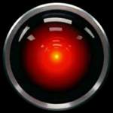
Meet HAL
2001: A Space Odyssey
  classic science fiction movie from 1969
HAL
  part of the story centers around an intelligent computer called HAL
  HAL is the “brains” of an intelligent spaceship
  in the movie, HAL can
    speak easily with the crew
    see and understand the emotions of the crew
    navigate the ship automatically
    diagnose on-board problems
    make life-and-death decisions
    display emotions
In 1969 this was science fiction: is it still science fiction?
http://www.youtube.com/watch?v=LE1F7d6f1Qk

Slide 7
Different Types of Artificial Intelligence
Modeling exactly how humans actually think – thinking humanly
  cognitive models of human reasoning .
Modeling exactly how humans actually act
  models of human behavior (what they do, not how they think)
Modeling how ideal agents “should think”
  models of “rational” thought (formal logic)
  note: humans are often not rational!
Modeling how ideal agents “should act”
  rational actions but not necessarily formal rational reasoning
  i.e., more of a black-box/engineering approach
Modern AI focuses on the last definition
  we will also focus on this “engineering” approach
  success is judged by how well the agent performs
  -- modern methods are also inspired by cognitive & neuroscience (how people think).

Slide 8

Acting humanly: Turing Test
Turing (1950) "Computing machinery and intelligence":
"Can machines think?" → "Can machines behave intelligently?"
Operational test for intelligent behavior: the Imitation Game
Suggested major components of AI:
- NLP- to enable it to communicate successfully in English
- KB- to store what it knows or hears
- Automated reasoning-to use stored information to answer questions and to draw new conclusions.
- ML- to adapt to new circumstances and to detect and extrapolate patterns.
Computer Vision – to perceive objects
Robotics – to manipulate object and move about.

Slide 9
Thinking humanly
determining how humans think: 3 ways
introspection—trying to catch our own thoughts as they go by
psychological experiments—observing a person in action
brain imaging—observing the brain in action.
Example: Allen Newell and Herbert Simon: GPS, the “General Problem Solver”
AI and cognitive science – incorporates neurophysiological evidence into computational models.
Thinking Rationally
Right thinking: irrefutable reasoning processes.
Logic: socrates is a man. All men are mortal: therefore socrates is mortal.

Slide 10
Acting rationally: rational agent
Rational behavior: Doing that was is expected to maximize
one’s “utility function” in this world.
An agent is an entity that perceives and acts.
A rational agent acts rationally.
This course is about designing rational agents
Abstractly, an agent is a function from percept histories to actions:
[f: P* → A]
For any given class of environments and tasks, we seek the agent (or class of agents) with the best performance
Caveat: computational limitations make perfect rationality unachievable
  → design best program for given machine resources

Slide 11
Academic Disciplines important to AI.
Philosophy Logic, methods of reasoning, mind as physical
system, foundations of learning, language,
rationality.
Mathematics Formal representation and proof, algorithms,
computation, (un)decidability, (in)tractability,
probability.
Economics utility, decision theory, rational economic agents
Neuroscience neurons as information processing units.
Psychology/ how do people behave, perceive, process Cognitive Science information, represent knowledge.
Computer building fast computers
engineering
Control theory design systems that maximize an objective
function over time
Linguistics knowledge representation, grammar

Slide 12
History of AI
1943 McCulloch & Pitts: Boolean circuit model of brain
1950 Turing's "Computing Machinery and Intelligence"
1956 Dartmouth meeting: "Artificial Intelligence" adopted
1950s Early AI programs, including Samuel's checkers
program, Newell & Simon's Logic Theorist,
Gelernter's Geometry Engine
1965 Robinson's complete algorithm for logical reasoning
1966—73 AI discovers computational complexity
Neural network research almost disappears
1969—79 Early development of knowledge-based systems
1980-- AI becomes an industry
1986-- Neural networks return to popularity
1987-- AI becomes a science
1995-- The emergence of intelligent agents
2001– Availability of Large Data Set

Slide 13
Consider what might be involved in building a “intelligent” computer….
What are the “components” that might be useful?
  Fast hardware?
  Foolproof software?
  Chess-playing at grandmaster level?
  Speech interaction?
    speech synthesis
    speech recognition
    speech understanding
  Image recognition and understanding ?
  Learning?
  Planning and decision-making?

Slide 14
Can we build hardware as complex as the brain?
How complicated is our brain?
  a neuron, or nerve cell, is the basic information processing unit
  estimated to be on the order of 10 ¹¹ neurons in a human brain
  many more synapses (10 ¹⁴) connecting these neurons
  cycle time: 10 ⁻³ seconds (1 millisecond)
How complex can we make computers?
  10⁶ or more transistors per CPU
  supercomputer: hundreds of CPUs, 10 ⁹ bits of RAM
  cycle times: order of 10 ⁻ ⁸ seconds
Conclusion
  YES: in the near future we can have computers with as many basic processing elements as our brain, but with
    far fewer interconnections (wires or synapses) than the brain
    much faster updates than the brain
  but building hardware is very different from making a computer behave like a brain!

Slide 15
Must an Intelligent System be Foolproof?
A “foolproof” system is one that never makes an error:
  Types of possible computer errors
    hardware errors, e.g., memory errors
    software errors, e.g., coding bugs
    “human-like” errors
  Clearly, hardware and software errors are possible in practice
  what about “human-like” errors?
An intelligent system can make errors and still be intelligent
  humans are not right all of the time
  we learn and adapt from making mistakes
    e.g., consider learning to surf or ski
      we improve by taking risks and falling
      an intelligent system can learn in the same way
Conclusion:
  NO: intelligent systems will not (and need not) be foolproof

Slide 16
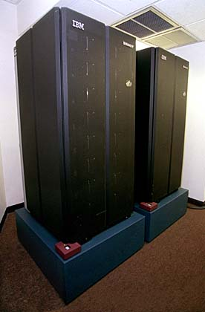

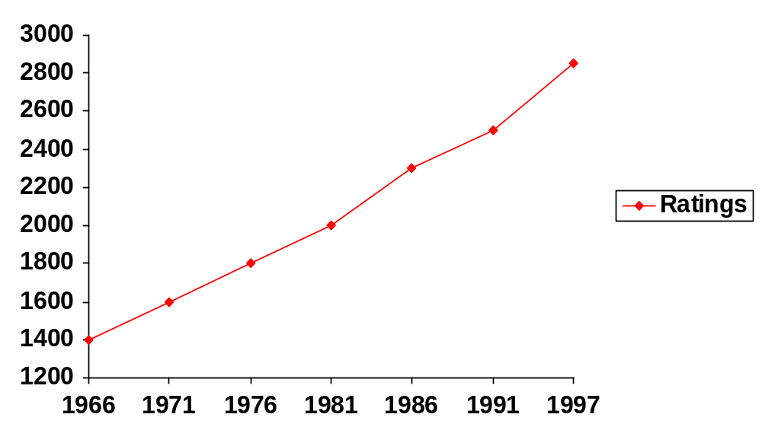
Can Computers play Humans at Chess?
Chess Playing is a classic AI problem
  well-defined problem
  very complex: difficult for humans to play well
Conclusion: YES: today’s computers can beat even the best human
Garry Kasparov (current World Champion)
Deep Blue
Deep Thought
Points Ratings

Slide 17
Can Computers Talk?
This is known as “speech synthesis”
  translate text to phonetic form
    e.g., “fictitious” -> fik-tish-es
  use pronunciation rules to map phonemes to actual sound
    e.g., “tish” -> sequence of basic audio sounds
Difficulties
  sounds made by this “lookup” approach sound unnatural
  sounds are not independent
    e.g., “act” and “action”
    modern systems (e.g., at AT&T) can handle this pretty well
  a harder problem is emphasis, emotion, etc
    humans understand what they are saying
    machines don’t: so they sound unnatural
Conclusion: NO, for complete sentences, but YES for individual words

Slide 18
Can Computers Recognize Speech?
Speech Recognition:
  mapping sounds from a microphone into a list of words.
  Hard problem: noise, more than one person talking,
  occlusion, speech variability,..
  Even if we recognize each word, we may not understand its meaning.
Recognizing single words from a small vocabulary
    systems can do this with high accuracy (order of 99%)
    e.g., directory inquiries
      limited vocabulary (area codes, city names)
      computer tries to recognize you first, if unsuccessful hands you over to a human operator
      saves millions of dollars a year for the phone companies

Slide 19
Recognizing human speech (ctd.)
Recognizing normal speech is much more difficult
  speech is continuous: where are the boundaries between words?
    e.g., “John’s car has a flat tire”
  large vocabularies
    can be many tens of thousands of possible words
    we can use context to help figure out what someone said
      try telling a waiter in a restaurant:
      “I would like some dream and sugar in my coffee”
  background noise, other speakers, accents, colds, etc
  on normal speech, modern systems are only about 60% accurate
Conclusion: NO, normal speech is too complex to accurately recognize, but YES for restricted problems
  (e.g., recent software for PC use by IBM, Dragon systems, etc)

Slide 20
Can Computers Understand speech?
Understanding is different to recognition:
  “Time flies like an arrow”
    assume the computer can recognize all the words
    but how could it understand it?
      1. time passes quickly like an arrow?
      2. command: time the flies the way an arrow times the flies
      3. command: only time those flies which are like an arrow
      4. “time-flies” are fond of arrows
    only 1. makes any sense, but how could a computer figure this out?
      clearly humans use a lot of implicit commonsense knowledge in communication
Conclusion: NO, much of what we say is beyond the capabilities of a computer to understand at present

Slide 21

Can Computers Learn and Adapt ?
Learning and Adaptation
  consider a computer learning to drive on the freeway
  we could code lots of rules about what to do
  and/or we could have it learn from experience
  machine learning allows computers to learn to do things without explicit programming
Conclusion: YES, computers can learn and adapt, when presented with information in the appropriate way
Darpa’s Grand Challenge. Stanford’s “Stanley” drove
150 without supervision in the Majove dessert

Slide 22
Can Computers “see”?
Recognition v. Understanding (like Speech)
  Recognition and Understanding of Objects in a scene
    look around this room
    you can effortlessly recognize objects
    human brain can map 2d visual image to 3d “map”
Why is visual recognition a hard problem?
Conclusion: mostly NO: computers can only “see” certain types of objects under limited circumstances: but YES for certain constrained problems (e.g., face recognition)

Slide 23
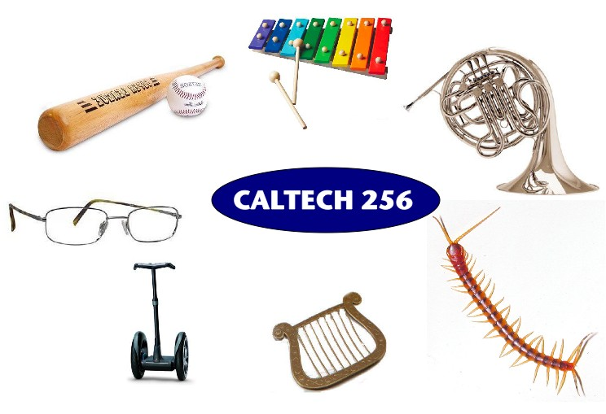
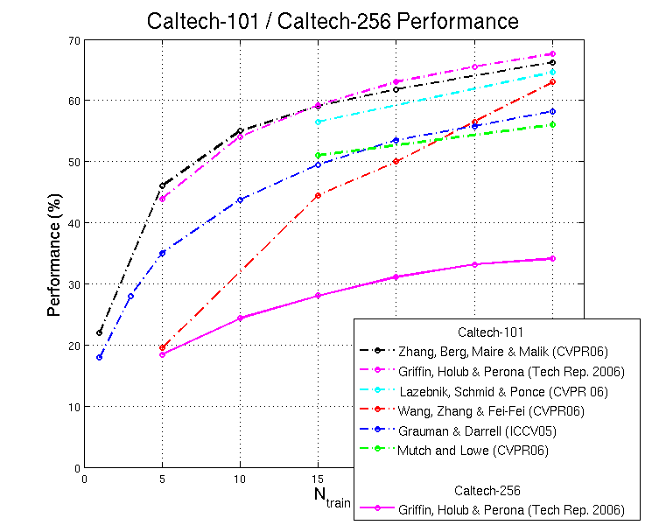
In the computer vision community
research compete to improve recognition
performance on standard datasets

Slide 24
Can Computers plan and make decisions?
Intelligence
  involves solving problems and making decisions and plans
  e.g., you want to visit your cousin in Boston
    you need to decide on dates, flights
    you need to get to the airport, etc
    involves a sequence of decisions, plans, and actions
What makes planning hard?
  the world is not predictable:
    your flight is canceled or there’s a backup on the 405
  there is a potentially huge number of details
    do you consider all flights? all dates?
      no: commonsense constrains your solutions
  AI systems are only successful in constrained planning problems
Conclusion: NO, real-world planning and decision-making is still beyond the capabilities of modern computers
  exception: very well-defined, constrained problems: mission planning for satelites.

Slide 25
Intelligent Systems in Your Everyday Life
Post Office
  automatic address recognition and sorting of mail
Banks
  automatic check readers, signature verification systems
  automated loan application classification
Telephone Companies
  automatic voice recognition for directory inquiries
Credit Card Companies
  automated fraud detection
Computer Companies
  automated diagnosis for help-desk applications
Netflix:
  movie recommendation
Google:
  Search Technology

Slide 26
AI Applications: Consumer Marketing
Have you ever used any kind of credit/ATM/store card while shopping?
  if so, you have very likely been “input” to an AI algorithm
All of this information is recorded digitally
Companies like Nielsen gather this information weekly and search for patterns
  general changes in consumer behavior
  tracking responses to new products
  identifying customer segments: targeted marketing, e.g., they find out that consumers with sports cars who buy textbooks respond well to offers of new credit cards.
  Currently a very hot area in marketing
How do they do this?
  Algorithms (“data mining”) search data for patterns
  based on mathematical theories of learning
  completely impractical to do manually

Slide 27
AI Applications: Identification Technologies
ID cards
  e.g., ATM cards
  can be a nuisance and security risk:
    cards can be lost, stolen, passwords forgotten, etc
Biometric Identification
  walk up to a locked door
    camera
    fingerprint device
    microphone
    iris scan
  computer uses your biometric signature for identification
    face, eyes, fingerprints, voice pattern, iris pattern

Slide 28
AI Applications: Predicting the Stock Market
Value of
the Stock
?
?
time in days
The Prediction Problem
  given the past, predict the future
  very difficult problem!
  we can use learning algorithms to learn a predictive model from historical data
    prob(increase at day t+1 | values at day t, t-1,t-2....,t-k)
  such models are routinely used by banks and financial traders to manage portfolios worth millions of dollars

Slide 29
AI-Applications: Machine Translation
Language problems in international business
  e.g., at a meeting of Japanese, Korean, Vietnamese and Swedish investors, no common language
  or: you are shipping your software manuals to 127 countries
  solution; hire translators to translate
  would be much cheaper if a machine could do this!
How hard is automated translation
  very difficult!
  e.g., English to Russian
      “The spirit is willing but the flesh is weak” (English)
      “the vodka is good but the meat is rotten” (Russian)
  not only must the words be translated, but their meaning also!
Nonetheless....
  commercial systems can do alot of the work very well (e.g.,restricted vocabularies in software documentation)
  algorithms which combine dictionaries, grammar models, etc.
  see for example babelfish.altavista.com

Slide 30
THE STATE OF THE ART
What can AI do today?
Robotic vehicles: A driverless robotic car named STANLEY sped through the rough terrain of the Mojave dessert at 22 mph, finishing the 132-mile course first to win the 2005 DARPA Grand Challenge.
STANLEY is a Volkswagen Touareg outfitted with cameras, radar, and laser rangefinders to sense the environment and onboard software to command the steering, braking, and acceleration (Thrun, 2006).
The following year CMU’s BOSS won the Urban Challenge, safely driving in traffic through the streets of a closed Air Force base, obeying traffic rules and avoiding pedestrians and other vehicles.

Slide 31
THE STATE OF THE ART- contd..
Speech recognition:
A traveler calling United Airlines to book a flight can have the entire conversation guided by an automated speech recognition and dialog management system.

Slide 32
THE STATE OF THE ART- contd..
Autonomous planning and scheduling:
A hundred million miles from Earth, NASA’s Remote Agent program became the first on-board autonomous planning program to control the scheduling of operations for a spacecraft (Jonsson et al., 2000).
REMOTE AGENT generated plans from high-level goals specified from the ground and monitored the execution of those plans—detecting, diagnosing, and recovering from problems as they occurred.
Successor program MAPGEN (Al-Chang et al., 2004) plans the daily operations for NASA’s Mars
Exploration Rovers, and MEXAR2 (Cesta et al., 2007) did mission planning—both logistics and science planning—for the European Space Agency’s Mars Express mission in 2008.

Slide 33
THE STATE OF THE ART- contd..
Game playing:
IBM’s DEEP BLUE became the first computer program to defeat the world champion in a chess match when it bested Garry Kasparov by a score of 3.5 to 2.5 in an exhibition match (Goodman and Keene, 1997).
Kasparov said that he felt a “new kind of intelligence” across the board from him. Newsweek magazine described the match as “The
brain’s last stand.” The value of IBM’s stock increased by $18 billion.
Human champions studied Kasparov’s loss and were able to draw a few matches in subsequent years, but the most recent human-computer matches have been won convincingly by the computer.

Slide 34
THE STATE OF THE ART- contd..
Spam fighting:
Each day, learning algorithms classify over a billion messages as spam, saving the recipient from having to waste time deleting what, for many users, could comprise 80% or 90% of all messages, if not classified away by algorithms.
Because the spammers are continually updating their tactics, it is difficult for a static programmed approach to keep up, and learning algorithms work best (Sahami et al., 1998; Goodman and Heckerman, 2004).

Slide 35
THE STATE OF THE ART- contd..
Logistics planning:
During the Persian Gulf crisis of 1991, U.S. forces deployed a Dynamic Analysis and Replanning Tool, DART (Cross and Walker, 1994), to do automated logistics planning and scheduling for transportation. This involved up to 50,000 vehicles, cargo, and people at a time, and had to account for starting points, destinations, routes, and conflict resolution among all parameters.
The AI planning techniques generated in hours a plan that would have taken weeks with older methods. The Defense Advanced Research Project Agency (DARPA) stated that this single application more than paid back DARPA’s
30-year investment in AI.

Slide 36
THE STATE OF THE ART- contd..
Robotics:
The iRobot Corporation has sold over two million Roomba robotic vacuum cleaners for home use.
The company also deploys the more rugged PackBot to Iraq and Afghanistan, where it is used to handle hazardous materials, clear explosives, and identify the location of snipers.

Slide 37
THE STATE OF THE ART- contd..
Machine Translation:
A computer program automatically translates from Arabic to English, allowing an English speaker to see the headline
“Ardogan Confirms That Turkey Would Not Accept Any Pressure, Urging Them to Recognize Cyprus.”
The program uses a statistical model built from examples of Arabic-to-English translations and from examples of English text totaling two trillion words (Brants et al., 2007).
None of the computer scientists on the team speak Arabic, but they do understand statistics and machine learning algorithms.

Slide 38
Problems
Monkey & Banana
Missionaries and cannibals
Water jug
8-puzzle
Chess
Theorem proving

Slide 39
A Water Jug Problem
You are given two jugs, a 4-gallon one and a 3-gallon one, a pump which has unlimited water which you can use to fill the jug, and the ground on which water may be poured. Neither jug has any measuring markings on it. How can you get exactly 2 gallons of water in the 4-gallon jug?
Soln.: Water jug

Slide 40
Missionaries and cannibals
On one side of a river, there are three missionaries and three cannibals. There is a boat which can be used to transfer people from one side of the river to the other.
No more than two people can fit in the boat and it must have at least one person in it during any transfer. The problem is to find the shortest sequence of transfers which gets all six people from one side to the other without ever creating a situation where missionaries outnumber cannibals on either side of the river. (The idea being that if this happens, the missionaries will then be able to corrupt the cannibals by 'converting' them.) To solve this problem satisfactorily, your program must explicitly identify all of the optimal (i.e., shortest) solutions to the problem.

Slide 41
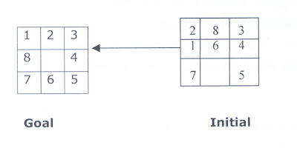
8 Puzzle Problem.
The 8 puzzle consists of eight numbered, movable tiles set in a 3x3 frame. One cell of the frame is always empty thus making it possible to move an adjacent numbered tile into the empty cell. Such a puzzle is illustrated in following diagram.
The program is to change the initial configuration into the goal configuration. A solution to the problem is an appropriate sequence of moves, such as “move tiles 5 to the right, move tile 7 to the left ,move tile 6 to the down, etc”.

